Slide 1

Digital Speech Processing
數位語音處理概論
第六講 Language Modelling
授課教師：國立臺灣大學 電機工程學系 李琳山 教授
【本著作除另有註明外，採取創用CC「姓名標示－非商業性－相同方式分享」台灣3.0版授權釋出】
References: 1. 11.2.2, 11.3, 11.4 of Huang or
2. 6.1- 6.8 of Becchetti, or
3. 4.1- 4.5, 8.3 of Jelinek
1

Slide 2

Language Modeling: providing linguistic constraints to help the selection of correct words
The computer is listening
電 腦 聽 聲 音
come
老 天
they
list
店
Fig. 1
tutor
Fig. 2
sunny
呻 吟
t
t
Prob [the computer is listening] > Prob [they come tutor is list sunny]
Prob [電腦聽聲音] > Prob [店老天呻吟]
2

Slide 3
From Fundamentals of Information Theory
Examples for Languages
0≤ H (S) ≤ log M
Source of English text generation
this course is about speech.....
the random variable is the character ⇒ 26*2+.....<64=2⁶
H (S) < 6 bits (of information) per character
the random variable is the word ⇒ assume total number of words=30,000<2¹⁵
H (S) < 15 bits (of information) per word
Source of speech for Mandarin Chinese
這一門課有關語音.....
the random variable is the syllable (including the tone) ⇒ 1300 < 2¹¹
H (S) < 11 bits (of information) per syllable (including the tone)
the random variable is the syllable (ignoring the tone) ⇒ 400 < 2⁹
H (S) < 9 bits (of information) per syllable (ignoring the tone)
the random variable is the character ⇒ 8,000 < 2¹³
H (S) < 13 bits (of information) per character
Comparison: speech― 語音, girl― 女孩, computer― 計算機
S
S
3

Slide 4
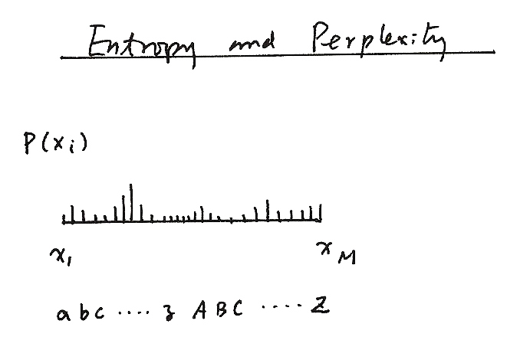
Entropy and Perplexity
Entropy and Perplexity
P(X_{i})
P (x_{i})
x₁ x_{M}
abc.....z ABC.....Z
Fig. 3
4

Slide 5

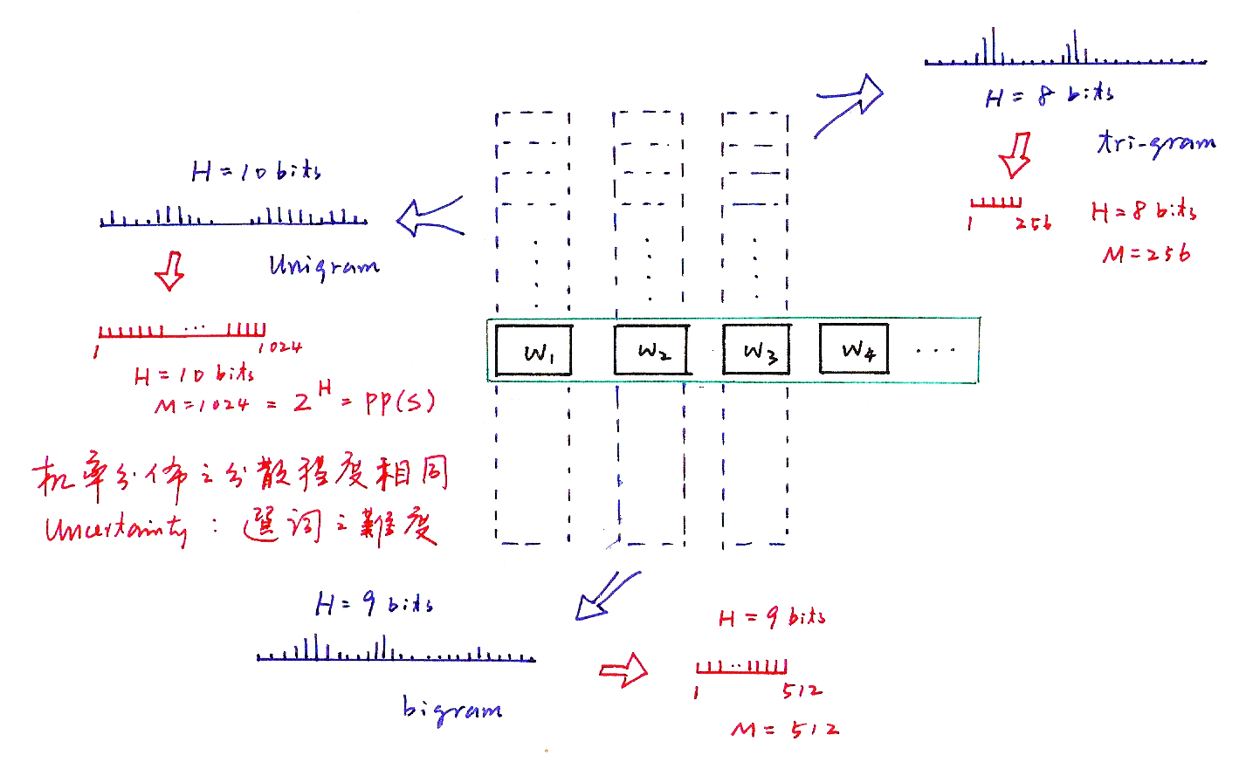
Entropy and Perplexity
機率分佈之分散程度相同
Uncertainty：選詞之難度
Fig. 4
5

Slide 6
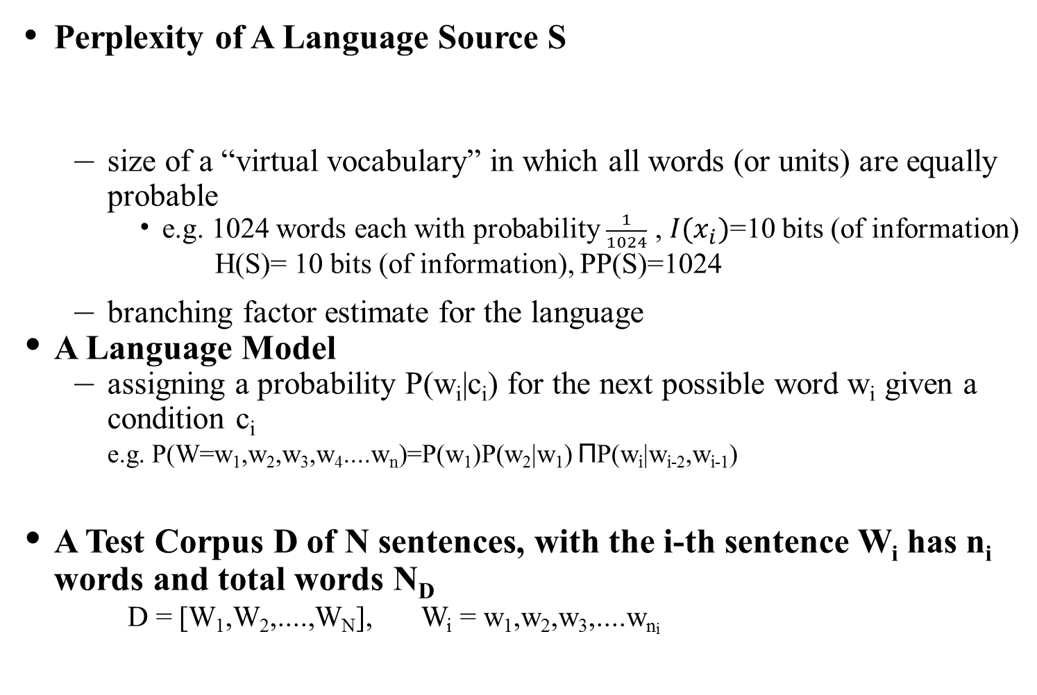

Perplexity
Perplexity of A Language Source S
size of a “virtual vocabulary” in which all words (or units) are equally probable
e.g. 1024 words each with probability $\frac{1}{1024}$ , $I(x_{i})$=10 bits (of information)
H(S)= 10 bits (of information), PP(S)=1024
branching factor estimate for the language
A Language Model
assigning a probability P(w_{i}|c_{i}) for the next possible word w_{i} given a condition c_{i}
e.g. P(W=w₁,w₂,w₃,w₄....w_{n})=P(w₁)P(w₂|w₁) ΠP(w_{i}|w_{i-2},w_{i-1})
A Test Corpus D of N sentences, with the i-th sentence W_{i} has n_{i} words and total words N_{D}
D = [W₁,W₂,....,W_{N}], W_{i} = w₁,w₂,w₃,....w_{ni}
(perplexity:混淆度)
n
i=3
c₁=$φ$
c₂
c_{i}
6

Slide 7
Perplexity
Perplexity of A Language Model P(w_{i}|c_{i}) with respect to a Test Corpus D
H (P ; D)= , average of all log P(w_{j}|c_{j}) over the
whole corpus D
= , logarithm of geometric mean of P(w_{j}|c_{j})
pp (P ; D) =2^{H(P;D)}
average branching factor (in the sense of geometrical mean of reciprocals)
e.g. P(W=w₁w₂...w_{n})=P(w₁) P(w₂|w₁) P(w₃|w₁,w₂) P(w₄|w₂,w₃) P(w₅|w₃,w₄) .....
the capabilities of the language model in predicting the next word given the linguistic constraints extracted from the training corpus
the smaller the better, performance measure for a language model with respect to a test corpus
a function of a language model P and text corpus D
7

Slide 8
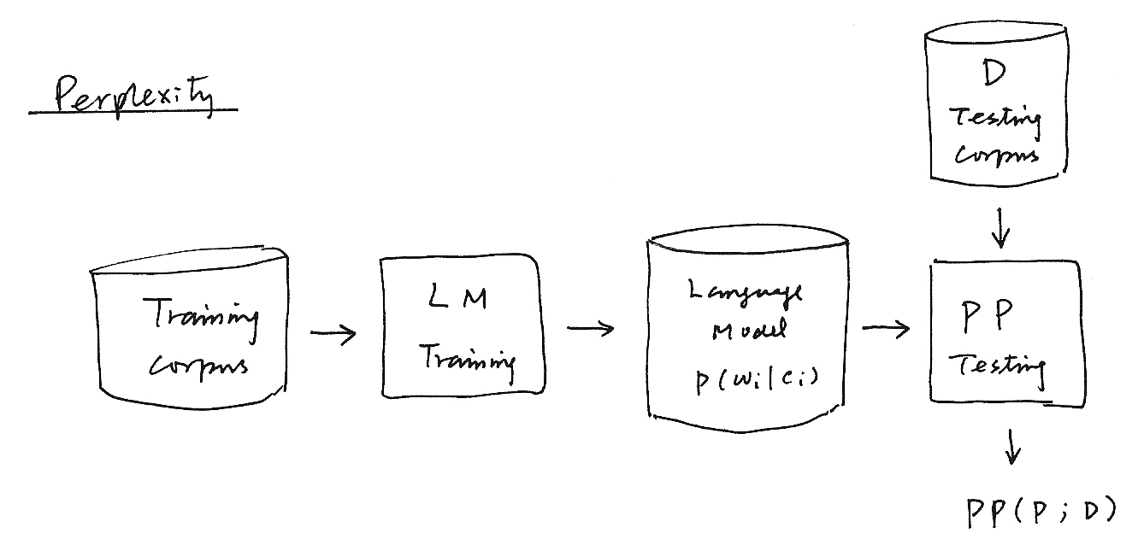
D
Testing
Corpus
Perplexity
Training corpus
Language
Model
P (w_{i} | c_{i})
LM
Training
PP
Testing
PP ( P；D )
8

Slide 9
An Perplexity Analysis Example with Respect to Different Subject Domains
Domain-specific Language Models Trained with Domain Specific Corpus of Much Smaller Size very often Perform Better than a General Domain Model
Training corpus: Internet news in Chinese language
Sports section gives the lowest perplexity even with very small training corpus
1 politics 19.6 M
2 congress 2.7 M
3 business 8.9 M
4 culture 4.3 M
5 sports 2.1 M
6 transportation 1.6 M
7 society 10.8 M
8 local 8.1 M
9 general(average) 58.1 M
～
～
0
1 2 3 4 5 6 7 8 9
Fig. 5
9

Slide 10
Perplexity
KL Divergence or Cross-Entropy
Jensen’s Inequality
entropy when p(x) is incorrectly estimated as q(x) (leads to some entropy increase)
The True Probabilities P(w_{i}|c_{i}) incorrectly estimated as P(w_{i}|c_{i}) by the language model
The Perplexity is a kind “Cross-Entropy” when the true statistical characteristics of the test corpus D is incorrectly estimated as p(w_{i}|c_{i}) by the language model
H (P ; D) = X (D‖ P)
the larger the worse
Someone call this “cross-entropy” = X[p(x)‖q(x)]
(averaging by all samples)
(averaging if p(x_{i}) is known)
law of large numbers
10

Slide 11
Law of Large Numbers
值 次數
a₁ n₁
a₂ n₂
+ a_{k} n_{k}
N
11

Slide 12
Smoothing of Language Models
Data Sparseness
many events never occur in the training data
e.g. Prob [Jason immediately stands up]=0 because Prob [immediately| Jason]=0
smoothing: trying to assign some non-zero probabilities to all events even if they never occur in the training data
Add-one Smoothing
assuming all events occur once more than it actually does
e.g. bigram
V: total number of distinct words in the vocabulary
12

Slide 13
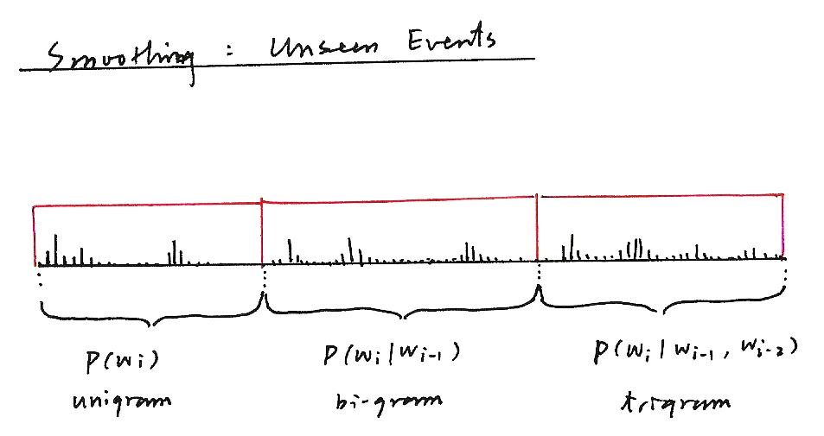
Smoothing : Unseen Events
Fig. 6
P(w_{i}) P(w_{i}|w_{i-1}) P(w_{i}|w_{i-2,} w_{i-1})
unigram bi-gram trigram
13

Slide 14
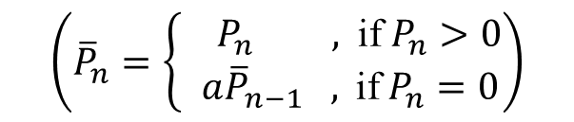
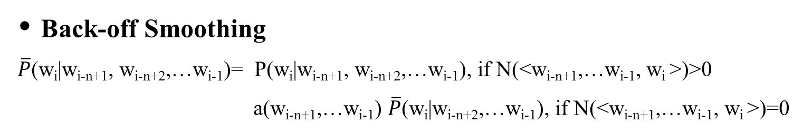

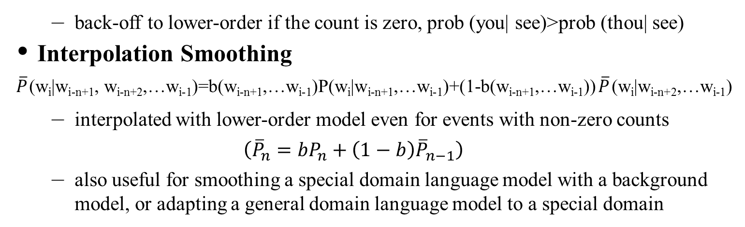
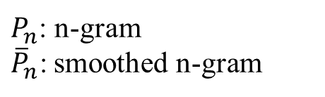
Smoothing of Language Models
Back-off Smoothing
$\overline{P}$(w_{i}|w_{i-n+1}, w_{i-n+2},…w_{i-1})= P(w_{i}|w_{i-n+1}, w_{i-n+2},…w_{i-1}), if N(<w_{i-n+1},…w_{i-1}, w_{i} >)>0
a(w_{i-n+1},…w_{i-1}) $\overline{P}$(w_{i}|w_{i-n+2},…w_{i-1}), if N(<w_{i-n+1},…w_{i-1}, w_{i} >)=0
$$\left({\overline{P}}_{n}=\left\{\begin{aligned}{ P}_{n}\text{ , }\text{if} P_{n}>0 \\ a{\overline{P}}_{n−1}\text{ , }\text{if} P_{n}=0\end{aligned}\right.\right)$$
$P_{n}$: n-gram
${\overline{P}}_{n}\text{:}$ smoothed n-gram
back-off to lower-order if the count is zero, prob (you| see)>prob (thou| see)
Interpolation Smoothing
$\overline{P}$(w_{i}|w_{i-n+1}, w_{i-n+2},…w_{i-1})=b(w_{i-n+1},…w_{i-1})P(w_{i}|w_{i-n+1},…w_{i-1})+(1-b(w_{i-n+1},…w_{i-1}))$\overline{P}$(w_{i}|w_{i-n+2},…w_{i-1})
interpolated with lower-order model even for events with non-zero counts
$$\left({\overline{P}}_{n}=bP_{n}+\left(1−b\right){\overline{P}}_{n−1}\right)$$
also useful for smoothing a special domain language model with a background model, or adapting a general domain language model to a special domain
$$P=bP_{s}+\left(1−b\right)P_{b}$$
14

Slide 15
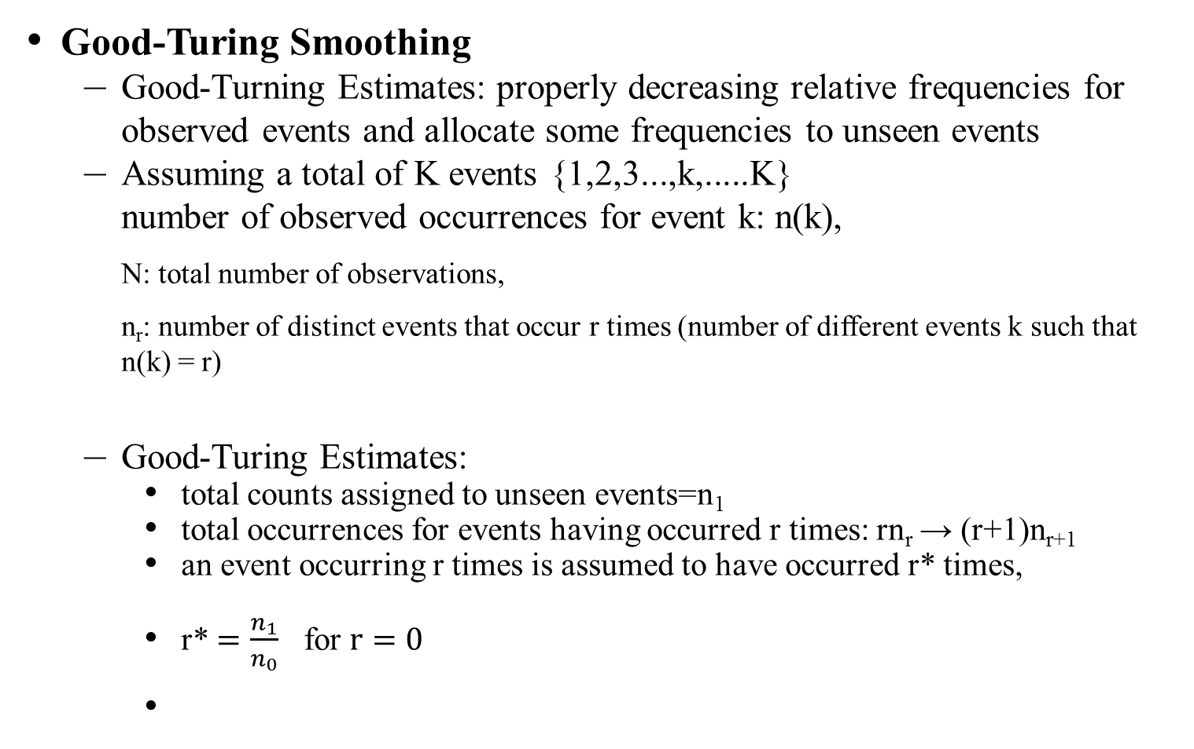
Smoothing of Language Models
Good-Turing Smoothing
Good-Turning Estimates: properly decreasing relative frequencies for observed events and allocate some frequencies to unseen events
Assuming a total of K events {1,2,3...,k,.....K}
number of observed occurrences for event k: n(k),
N: total number of observations,
n_{r}: number of distinct events that occur r times (number of different events k such that n(k) = r)
Good-Turing Estimates:
total counts assigned to unseen events=n₁
total occurrences for events having occurred r times: rn_{r} → (r+1)n_{r+1}
an event occurring r times is assumed to have occurred r* times,
r* $=\frac{n_{1}}{n_{0}}$ for $r=0$
15

Slide 16
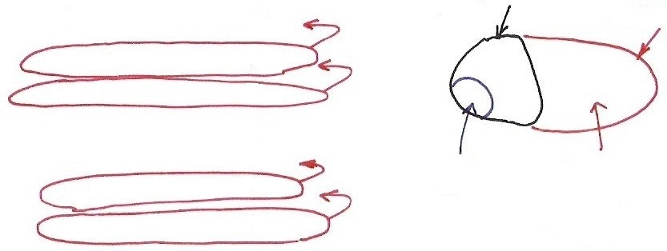










Good-Turing
出現該次數
之不同event數
次數
seen events
unseen
events：994
0
$$n_{0}$$
1
$$n_{1}$$
2
$$n_{2}$$
$$⋮$$
$$\frac{3/{18}}{994}$$
$$\frac{3}{18}$$
$$n_{r}$$
r
Fig. 7
r+1
$$n_{r+1}$$
$$⋮$$
$$⋮$$
An analogy: during fishing, getting each kind of fish is an event
an example: n(1)=10, n(2)=3, n(3)=2, n(4)= n(5)= n(6)=1, N=18
prob (next fish got is of a new kind) = prob (those occurring only once) =
16

Slide 17
Smoothing of Language Models
Katz Smoothing
large counts are reliable, so unchanged
small counts are discounted, with total reduced counts assigned to unseen events, based on Good-Turing estimates
,
distribution of counts among unseen events based on next-lower-order model: back off
an example for bigram:
d_{r}: discount ratio for events with r times
N (< w_{i-1},w_{i} >) / N(w_{i}) , r > r₀
d_{r}‧N (< w_{i-1},w_{i} >) / N(w_{i}) , r₀ ≥ r > 0
a (w_{i-1},w_{i}) P(w_{i}) , r = 0
a (w_{i-1},w_{i}): such that the total counts equal to those assigned
17

Slide 18

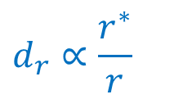
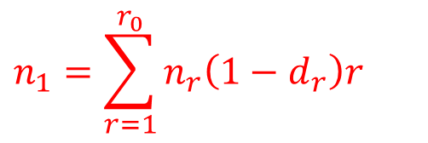
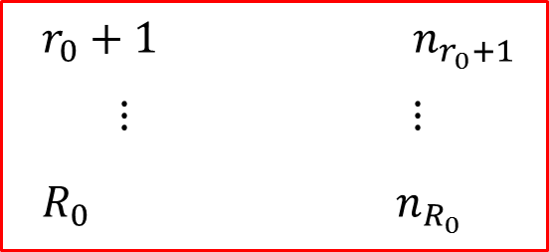
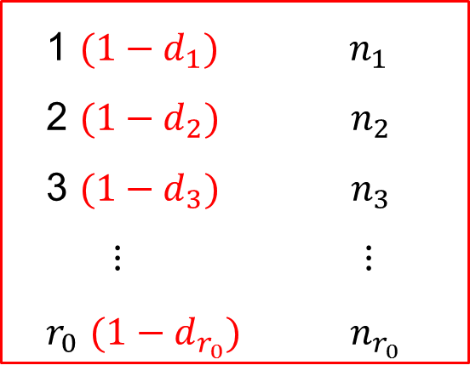
Katz Smoothing
不同event數
次數
0 $n_{0}$
1 $(1−d_{1})$ $n_{1}$
2 $(1−d_{2})$ $n_{2}$
3 $(1−d_{3})$ $n_{3}$
$⋮$ $⋮$
$r_{0}$ $(1−d_{r_{0}})$ $n_{r_{0}}$
$$n_{1}=\sum_{r=1}^{r_{0}}{n_{r}\left(1−d_{r}\right)r}$$
$$d_{r}∝\frac{r^{∗}}{r}$$
$r_{0}+1$ $n_{r_{0}+1}$
$⋮$ $⋮$
$R_{0}$ $n_{R_{0}}$
unchanged
18

Slide 19
Class-based Language Modeling
Clustering Words with Similar Semantic/Grammatic Behavior into Classes
e.g.
P(w_{i}|w_{i-2}, w_{i-1}) ⇒ P(w_{i}|c(w_{i}))P(c(w_{i})|c(w_{i-2}), c(w_{i-1}) )
c(w_{j}): the class including w_{j}
Smoothing effect: back-off to classes when too few counts, classes complementing the lower order models
parameter size reduced
Limited Domain Applications: Rule-based Clustering by Human Knowledge
e.g. Tell me all flights of from to on
new items can be easily added without training data
General Domain Applications: Data-driven Clustering (probably aided by rule-based knowledge)
saw
found
dog
cat
street
road
John
Marry
a
on
the
He
She
drove
rode
car
bus
campus
in
My
father
sister
park
United
China Airline
Eva Air
Taipei
Los Angeles
Sunday
19

Slide 20
Class-based Language Modeling
Data-driven Word Clustering Algorithm Examples
Example 1:
initially each word belongs to a different cluster
in each iteration a pair of clusters was identified and merged into a cluster which minimizes the overall perplexity
stops when no further (significant) reduction in perplexity can be achieved
Reference: “Cluster-based N-gram Models of Natural Language”, Computational Linguistics, 1992 (4), pp. 467-479
Example 2:
Prob [W= w₁w₂w₃....w_{n}]= Π Prob(w_{i}|w₁,w₂....w_{i-1})= Π Prob(w_{i}|h_{i})
h_{i}: w₁,w₂,...w_{i-1}, history of w_{i}
clustering the histories into classes by decision trees (CART)
developing a question set, entropy as a criterion
may include both grammatic and statistical knowledge, both local and long-distance relationship
Reference: “A Tree-based Statistical Language Model for Natural Language Speech Recognition”, IEEE Trans. Acoustics, Speech and Signal Processing, 1989, 37 (7), pp. 1001-1008
n
i=1
n
i=1
20

Slide 21
An Example Class-based Chinese Language Model
A Three-stage Hierarchical Word Classification Algorithm
stage 1 : classification by 198
POS features (syntactic & semantic)
each word belonging to one class only
each class characterized by a set of POS’s
stage 2 : further classification with data-driven approaches
stage 3 : final merging with data-driven approaches
all words
.....
.....
.....
.....
.....
坐
(take)
汽車
(car)
乘
(ride)
巴士
(bus)
POS feature i
POS feature j
搭
(ride)
火車
(train)
飛機
(airplane)
...
...
...
.......
...
...
...
...
駕駛
(drive)
開
(steer)
.....
.....
.....
.....
21
rarely used words classified by human knowledge
both data-driven and human-knowledge-driven

Slide 22
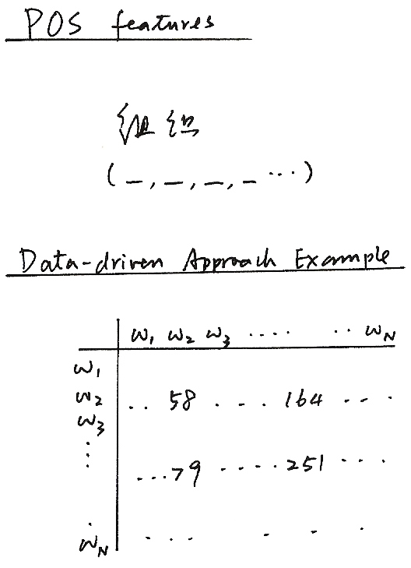
POS features
組織
(_,_,_,_...)
Data-driven Approach Example
Fig. 8
22

Slide 23
Structural Features of Chinese Language
Almost Each Character with Its Own Meaning, thus Playing Some Linguistic Role Independently
No Natural Word Boundaries in a Chinese Sentence
電腦科技的進步改變了人類的生活和工作方式
word segmentation not unique
words not well defined
commonly accepted lexicon not existing
Open ( Essentially Unlimited ) Vocabulary with Flexible Wording Structure
– new words easily created everyday 電(electricity)+腦(brain)→電腦(computer)
– long word arbitrarily abbreviated 臺灣大學 (Taiwan University) →臺大
– name/title 李登輝前總統 (former President T.H. Lee) →李前總統登輝
– unlimited number of compound words 高 (high) + 速 (speed) + 公路 (highway)→高速公路(freeway)
Difficult for Word-based Approaches Popularly Used in Alphabetic Languages
– serious out-of-vocabulary(OOV) problem
23

Slide 24
Word-based and Character-based Chinese Language Models
Word-based and Class-based Language Modeling
words are the primary building blocks of sentences
more information may be added
lexicon plays the key role
flexible wording structure makes it difficult to have a good enough lexicon
accurate word segmentation needed for training corpus
serious “out-of -vocabulary(OOV)” problem in many cases
all characters included as “ mono-character words”
Character-based Language Modeling
avoiding the difficult problem of flexible wording structure and undefined word boundaries
relatively weak without word-level information
higher order N-gram needed for good performance, which is relatively difficult to realize
Integration of Class-based/Word-based/Character-based Models
word-based models are more precise for frequently used words
back-off to class-based models for events with inadequate counts
each single word is a class if frequent enough
character-based models offer flexibility for wording structure
24

Slide 25
Segment Pattern Lexicon for Chinese – An Example Approach
Segment Patterns Replacing the Words in the Lexicon
segments of a few characters often appear together : one or a few words
regardless of the flexible wording structure
automatically extracted from the training corpus (or network information) statistically
including all important patterns by minimizing the perplexity
Advantages
bypassing the problem that the word is not well-defined
new words or special phrases can be automatically included as long as they appear frequently in the corpus (or network information)
can construct multiple lexicons for different task domains as long as the corpora are given(or available via the network)
25

Slide 26
Example Segment Patterns Extracted from Network News Outside of A Standard Lexicon
Patterns with 2 Characters
一套，他很，再往，在向，但從，苗市，記在
深表，這篇，單就，無權，開低，蜂炮，暫不
Patterns with 3 Characters
今年初，反六輕，半年後，必要時，在七月
次微米，卻只有，副主委，第五次，陳水扁，開發中
Patterns with 4 Characters
大受影響，交易價格，在現階段，省民政廳，專責警力
通盤檢討，造成不少，進行了解，暫停通話，擴大臨檢
26

Slide 27
Word/Segment Pattern Segmentation Samples
With Extracted Segment Pattern
交通部 考慮 禁止 民眾 開車 時
使用 大哥大
已 委由 逢甲大學 研究中
預計 六月底 完成
至於 實施 時程
因涉及 交通 處罰 條例 的修正
必須 經立法院 三讀通過
交通部 無法確定
交通部 官員表示
世界 各國對 應否 立法 禁止 民眾
開車 時 打 大哥大
意見 相當 分岐
With A Standard Lexicon
交通部 考慮 禁止 民眾 開 車 時
使用 大哥大
已 委 由 逢甲大學 研究 中
預計 六月 底 完成
至於 實施 時 程
因 涉及 交通 處罰 條例 的 修正
必須 經 立法院 三讀通過
交通部 無法 確定
交通部 官員 表示
世界 各 國 對 應否 立法 禁止
民眾 開 車 時 打 大哥大
意見 相當 分岐
Percentage of Patterns outside of the Standard Lexicon : 28%
27

Slide 28
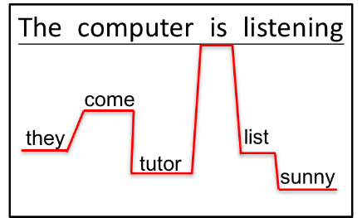
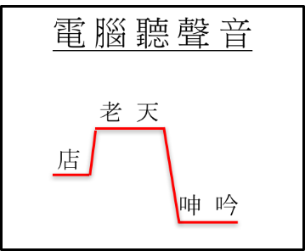
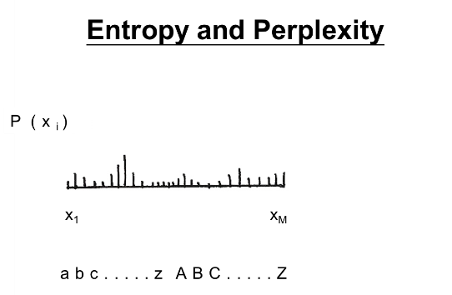

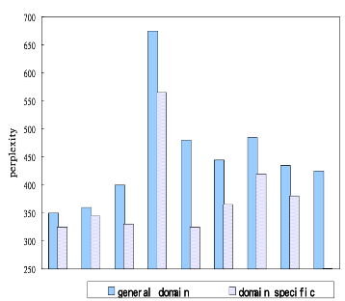
版權聲明
頁碼 | 作品 | 版權標示 | 作者／來源
2 |  |  | 國立台灣大學電機工程學系 李琳山 教授。本作品採用創用CC「姓名標示-非商業性-相同方式分享3.0臺灣」許可協議。
4 |  |  | 國立台灣大學電機工程學系 李琳山 教授。本作品採用創用CC「姓名標示-非商業性-相同方式分享3.0臺灣」許可協議。
5 |  |  | 國立台灣大學電機工程學系 李琳山 教授。本作品採用創用CC「姓名標示-非商業性-相同方式分享3.0臺灣」許可協議。
9 |  |  | 國立台灣大學電機工程學系 李琳山 教授。本作品採用創用CC「姓名標示-非商業性-相同方式分享3.0臺灣」許可協議。
28

Slide 29
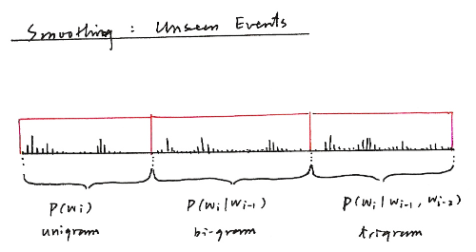

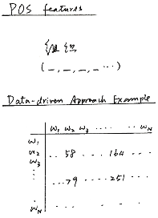
版權聲明
頁碼 | 作品 | 版權標示 | 作者／來源
13 |  |  | 國立台灣大學電機工程學系 李琳山 教授。本作品採用創用CC「姓名標示-非商業性-相同方式分享3.0臺灣」許可協議。
16 |  |  | 國立台灣大學電機工程學系 李琳山 教授。本作品採用創用CC「姓名標示-非商業性-相同方式分享3.0臺灣」許可協議。
22 |  |  | 國立台灣大學電機工程學系 李琳山 教授。本作品採用創用CC「姓名標示-非商業性-相同方式分享3.0臺灣」許可協議。
29

